Slide 1
Comparing Reality to the Myths of EV driving
A case study to ease the anxieties of first time EV buyers

Slide 2
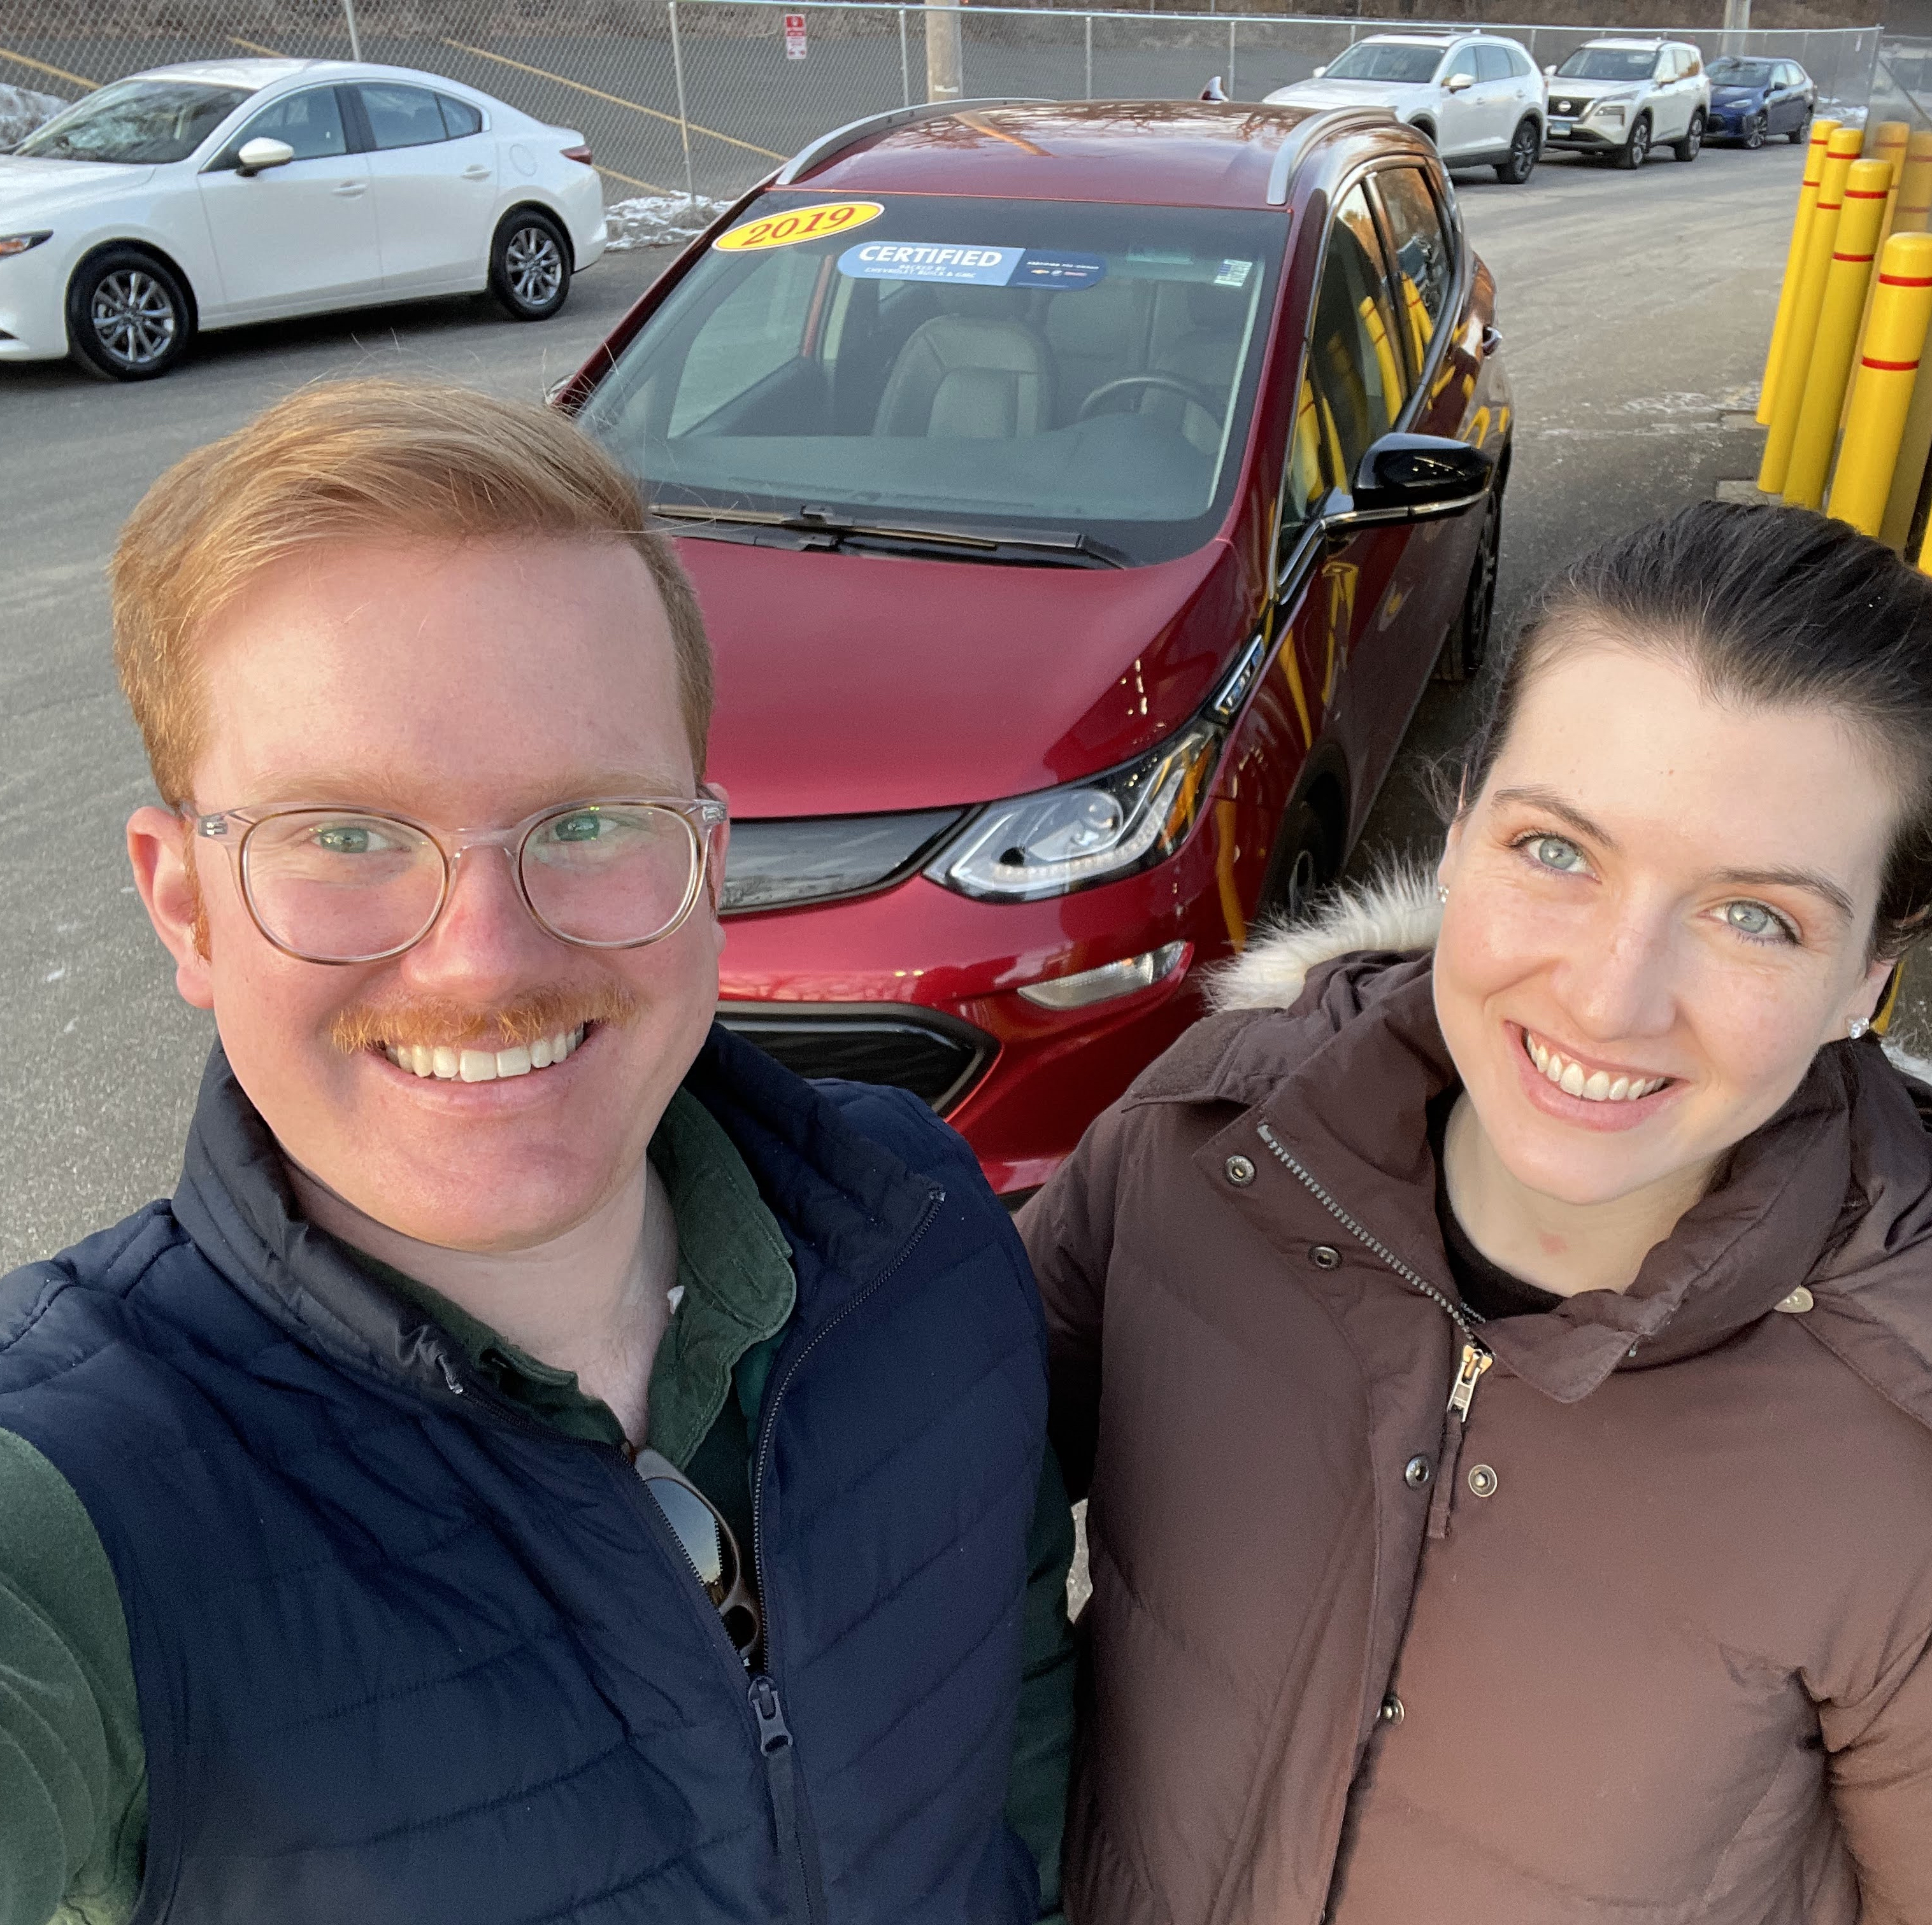
2019 Chevy Bolt (Fully Electric)
66 kWh Battery (Difficult to switch to this language)
Subcompact car
Notes:
When making the decision to buy an electric vehicle last February, I was stuck wrestling the competing narratives behind the pros and cons behind ‘going electric’.
The car I had my heart set on, and eventually bought, was a Fully Electric 2019 Chevy Bolt, The successor to the very popular plug in hybrid vehicle, the chevy Volt
Obviously there was the clear marketed data of 238 mi range, but I had read a lot about low temperatures having a big affect on range, in some vehicles reducing their range by 20-30%
But every electric vehicle apparently has different performance on this.
Other than some tangential Chevy Bolt forums , there wasn’t any real world data on the vehicle I was interested in to adiquetly make my decision.
Switching from a gas vehicle to an electric vehicle felt like jumping into the unknown.
(% of ev’s on the road) with x% of ev’s on the road, I thought for sure there would be someone who has the data of what the battery range was in the winder time, or what an average efficiency was, but that was not the case and made the purchase of my vehicle a more difficult decision. You’d think that maybe they would have some clear numbers in a pamphlet for the vehicle, butI couldn’t find any, and the salespeople at every dealer were not knowledge about electric vehicles or their corks.
The quality of salespeople are not able to deal with the speed of data coming at them. How to move electric vehicles . Others out there may have the same experience where you may be the first of your friends and family to jump into an electric vehicle. This is why I started that project.
And the chevy bolt was difficult to find data online about, a lot of data on teslas, but no data on this car even though it was the more affordable car!!!

Slide 3
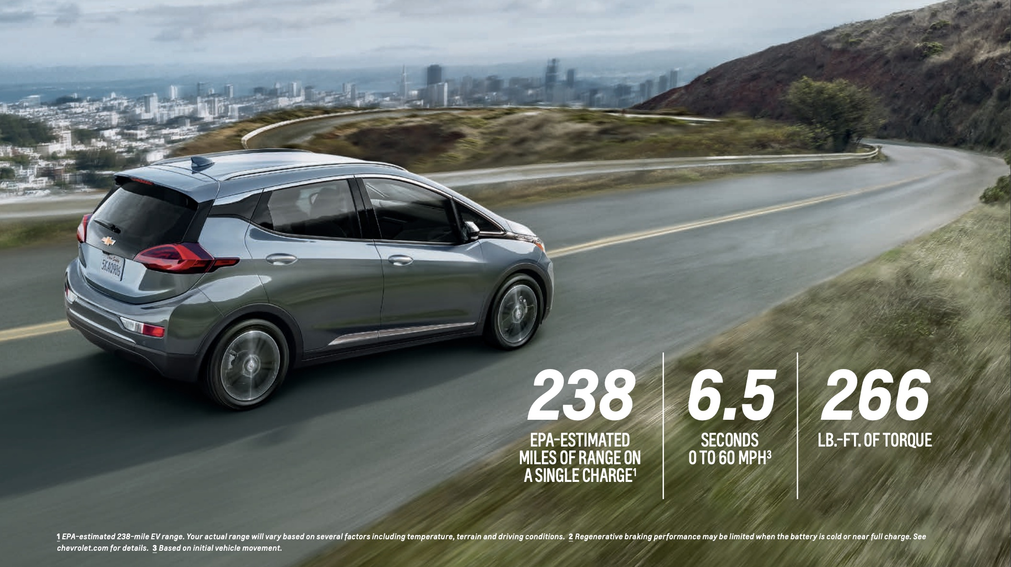
HERE IS WHAT WAS MARKETED TO ME

Slide 4
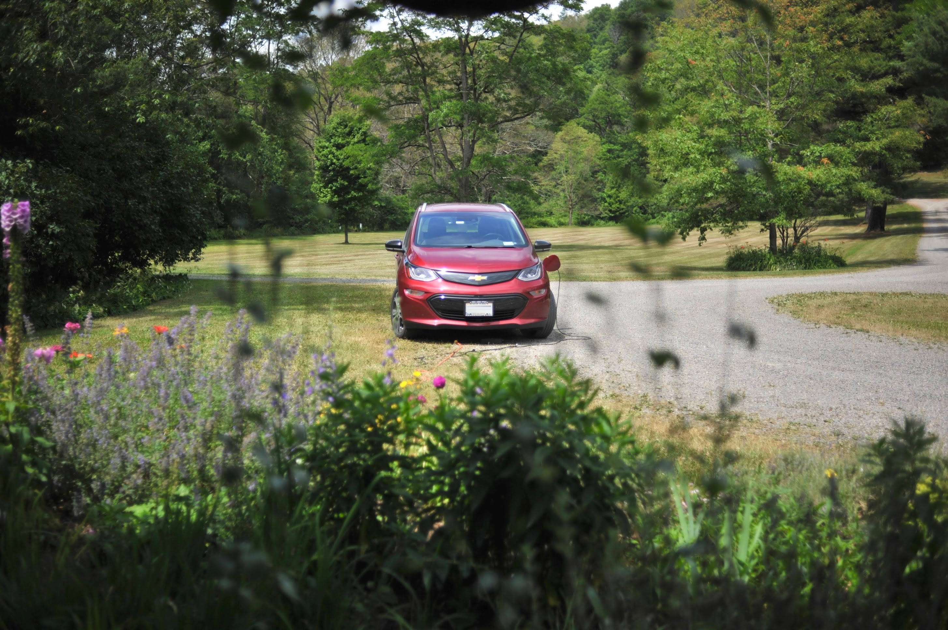
Myth #1: EV’s can’t drive very far, and I’ll run out of battery
Myth#2: An EV’s range is really bad, especially in the wintertime
Myth #3: It’ll cost me a as much if not more to charge my own car at home

Slide 5
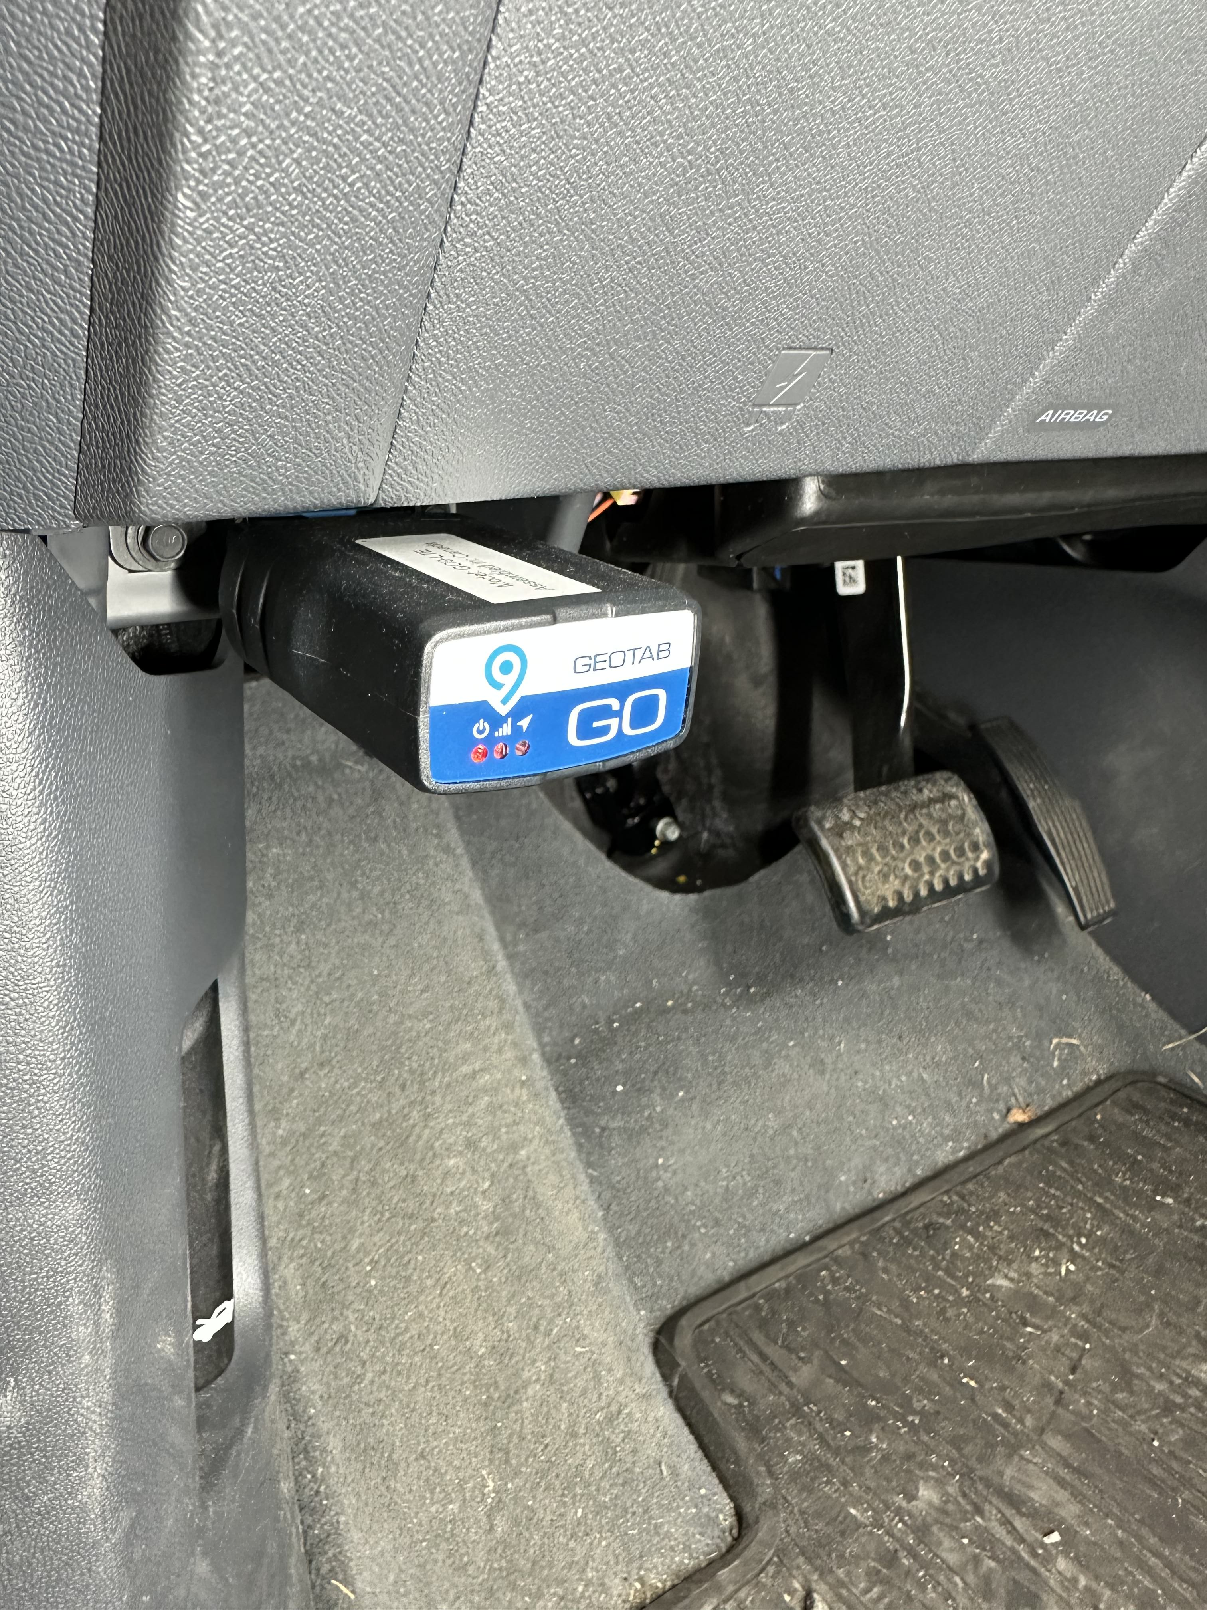
Data Collection Process
Every single trip (i.e car on and off)
Wifi/Cell Service to report
Collected data like:
outside temperature
electricity used
Effeciency
start time
end time,
etc
NOT GPS

Slide 6


About the Data Set
Mostly around Westchester Area/NYC, with long trips to Western NY, Philly, DC. Etc.
Date range 2/24/22 – 12/17/22
Average American drives 36.9 miles per day *
I drive an avg of 67.4 mi per day
*US Federal Highway Administration
Frequent driver: 1092 trips,296 days , 3.69 trips
totaling 17,400 miles ,
So in case you were
Worried “no no, I drive too much
For an ev to be practical for me”
Don’t worry I drive more than the average
US driver
Outside Temperature range from 23-100F
After analyzing the dataset, I was able to address these
myths with more confidence

Slide 7
I analyzed each of the variables, and was able to find some answers
To these myths found some insights along the way.
So… MYTH 1: EV’s Can’t drive very far and I’ll run out of battery.

Slide 8
MYTH 1: EV’s Can’t drive very far and I’ll run out of battery.
AVG of 73% charge status
Meaning on average I would start a trip with 216 miles of range
And on avg I would End every trip with 199 miles of range.
And this is for every trip.
LONGEST single stint: 177 mi
Most mi per day: 351.69
Ended trip with 5% only twice
My avg. trip was 15.9 miles long. And on average I drive 67.4 per day
And I’ve never run out of battery
I took 25 trips over 90 miles
Notes:
I never rang out of battery once.

Slide 9
What Else did I find when looking into distance/efficiency?
So an electric vehicle can handle a frequent driver, but how efficient is it?
On all 1092 trips I avg’d 4.5 mikWh or 152 MPGeq
Does anything in particular influence that efficiency?--> leads to temp influencing mikWh
Let’s ecplore some of the other data points to see!
-Distance
-Time of day
-Temperature

Slide 10
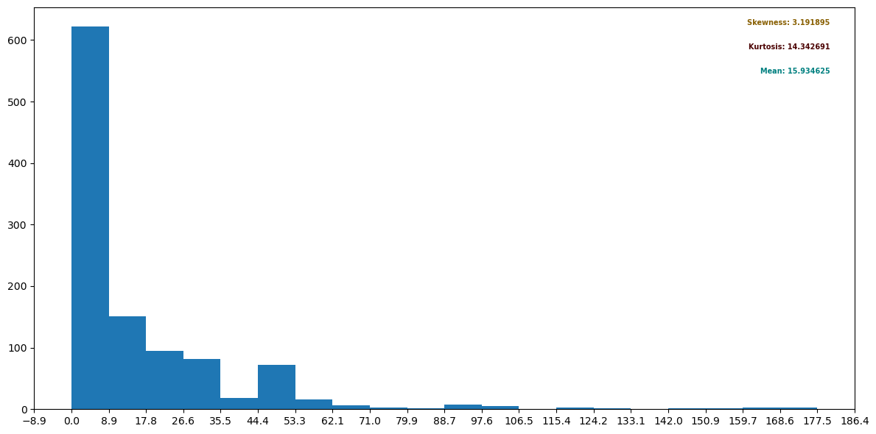
Distance hist

Slide 11
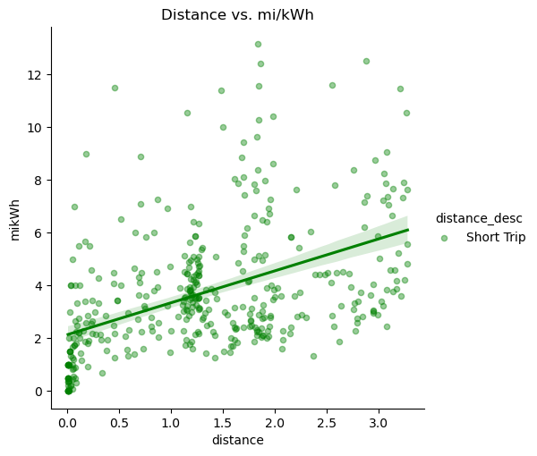

Slide 12
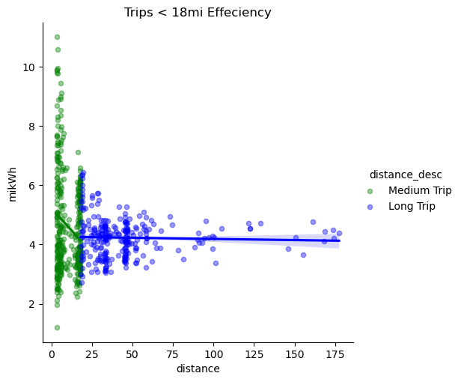

Slide 13
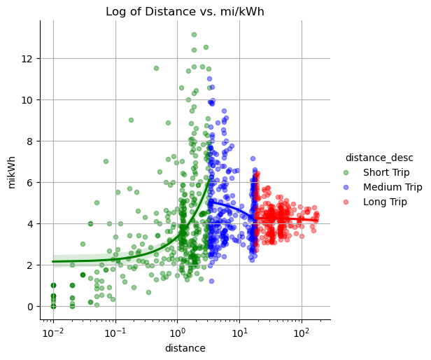

Slide 14
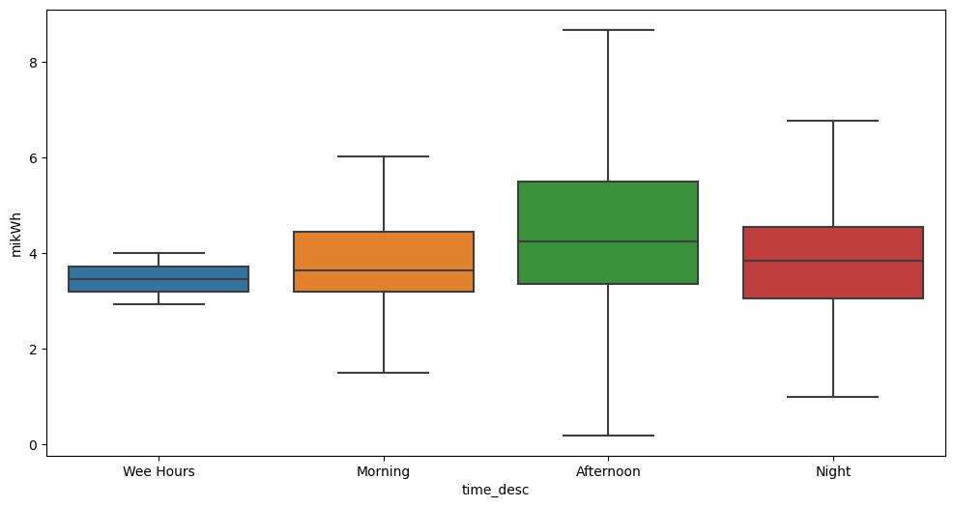
What about time of day?

Slide 15
Leads us into
MYTH #2 EV Range is really bad, especially in the winter time
Let’s talk through the temperature part, because we already addressed the range portion of it

Slide 16
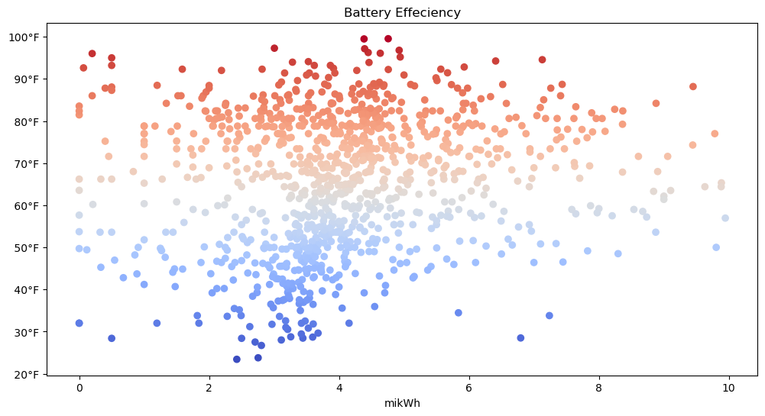

Slide 17
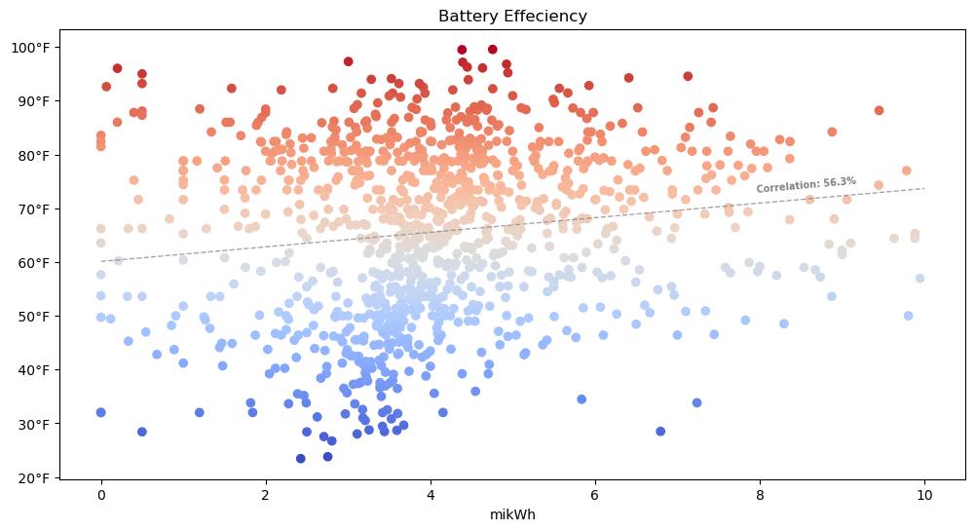

Slide 18

MYTH #2 CONFIRMED.
But how much of a degradation are we talking about?
If the battery is charged to 100%
70 miles lost in the winter time!!
I’ll say for daily driving it doesn’t make a difference!!!
Just on those long trips
Particularly I’ve found I prefer to only stop ONCE On a road trip, meaning whatever the range is, double it, and that’s the max trip you can make, i.e. in the cold, I could drive 460 miles(NYC→north Carolina) and in the warm I could drive 600 mi journey.(NYC→South Carolina)

Slide 19
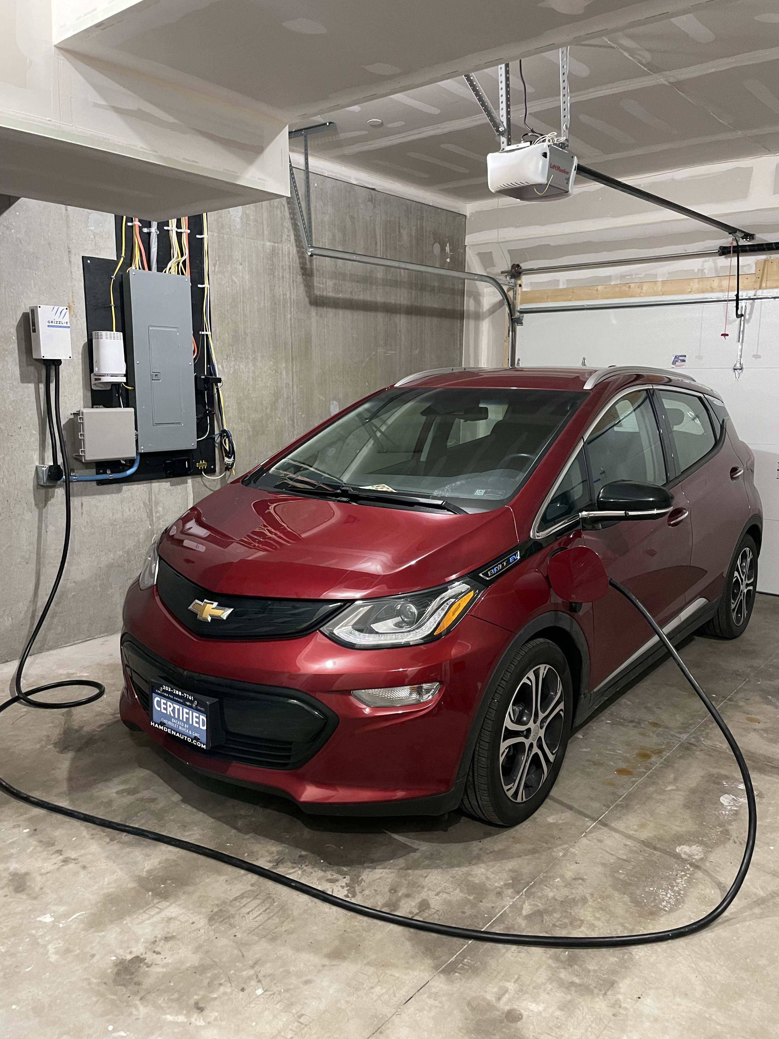
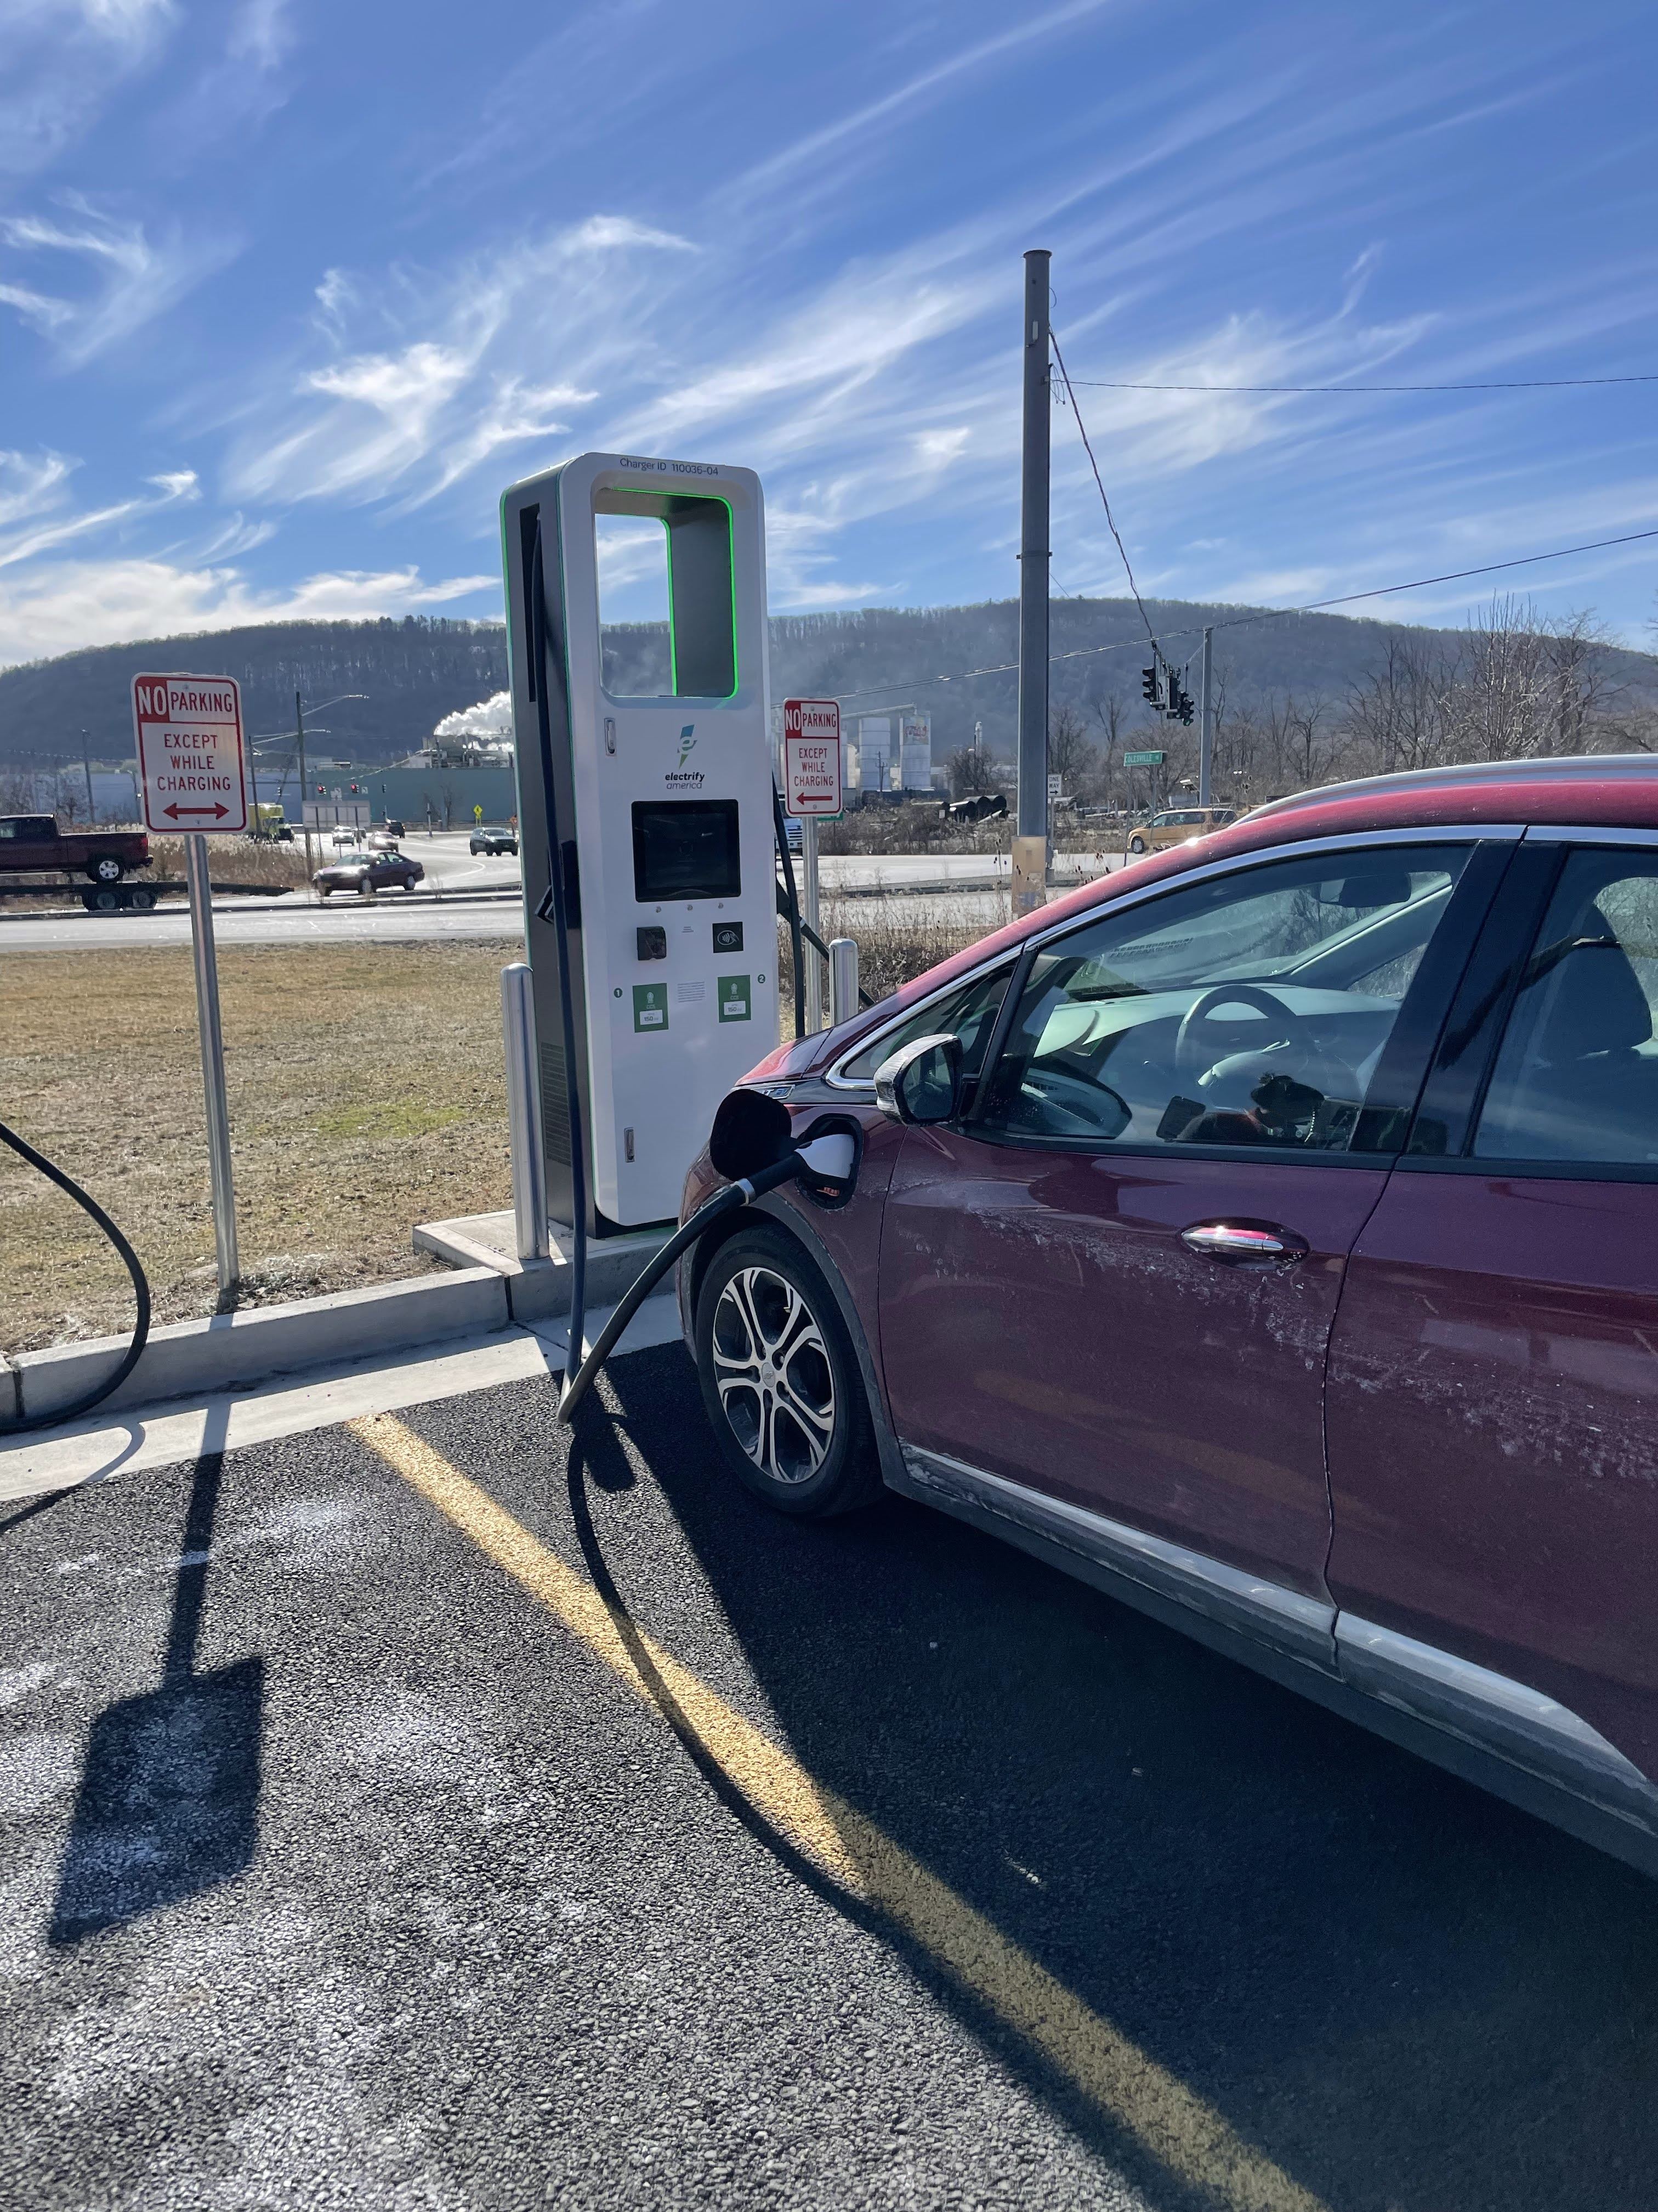
Notes and ideas about RANGE.
lifestyle

Slide 20
Myth #3: It’ll cost me a as much if not more to charge my own car at home
than just filling up at a gas station
Let’s talk about cost savings!!

Slide 28

"Data isn’t units of information. Data is a story about human behavior - about real people's wants, needs, goals and fears. Never let the numbers, platforms, charts and methodologies cloud your vision. Our real job with data is to better understand these very human stories, so we can better serve these people. Every goal your business has is directly tied to your success in understanding and serving people."
~ Daniel Burstein

Slide 29
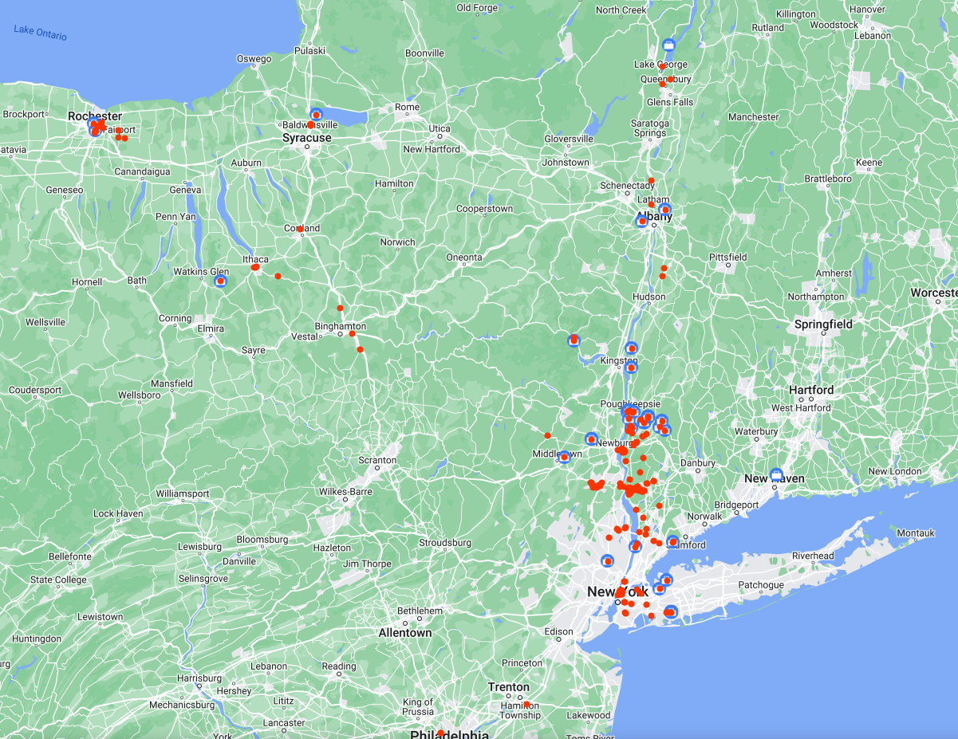
For the Future:
I could collect GPS data
Or merge my google maps data
And collect data on elevation
changes
Etc.
This is my google maps timeline

